Slide 1
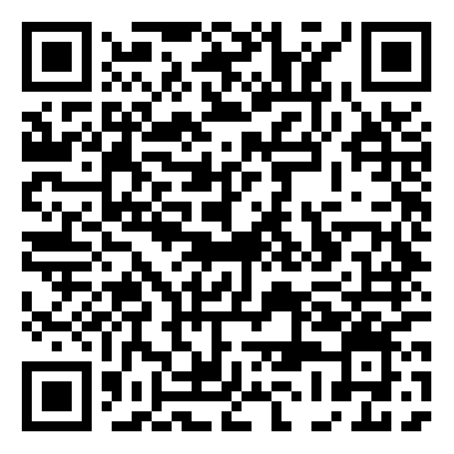
LEARNING MANAGEMENT SYSTEM
CS-409 PROJECT

Slide 2
Developers
ABDUL MOIZ AFTAB
AHMED MAQSOOD
AHMED ILYAS
2024-AG-9203
2024-AG-8790
2024-AG-8958

Slide 3
Introduction
This project is a simple, command-line-based LMS written in C++.
It simulates the core functions of an academic management system used to handle student and teacher information.
The program uses object-oriented design to separate responsibilities between the LMS, the admin, and the student.
Each part interacts with shared data through inheritance, creating a structured and modular academic management system.

Slide 4
C++ and OOP concepts used in this code
Following are the concepts we used in this code
Classes | While loop
Encapsulation | Random numbers
Inheritance | If else statements
Parameters | Destructor
Vectors | Goto statement
Increment operators | For loop

Slide 5
Key features of LMS
01
02
03
04
New Account
Student Portal
Admin Portal (Teacher)
Password Recovery

Slide 6
01. New account
Create new student account.
Enter your name and cnic.
It checks whether credentials are valid or not.
It check length of Cnic.
It assigns Ag number and Password by itself to new student.

Slide 7
02. Student Portal
View profile information.
View enrolled courses.
Check GPA and CGPA.
Submit course/teacher reviews.

Slide 8
03. Admin Portal (Teacher)
Admin AG#: 2021ag2248
Admin Password.
View admin profile.
View full student records.
Read all student reviews.
Edit student information (name, CNIC, password).
Edit admin information.

Slide 9
04. Password Recovery
If student inputs wrong credential 3 or more times then it gives an option to recover the password:
Recovery keys for students:
- 2024ag8790
- 2024ag9203
- 2024ag8958
If admin forgets his password then he can enter password recovery mode by typing 2021ag2248FP in the first interface.
Admin Recovery Key : ----------

Slide 10



Class Structure
LMS (Parent)
Admin Portal (Child)
Student Portal (child)

Slide 11
LMS (PARENT)
This base class contains:
Vectors storing student names, AG numbers, CNIC numbers, passwords, GPAs, and CGPAs.
Functions for creating new accounts, logging into existing accounts, and handling repeated failed login attempts.
Logic for password recovery.

Slide 12
Admin Portal (Child)
Inherits from LMS.
Adds admin-specific abilities:
- Admin login
- Displaying all student data
- Viewing reviews
- Editing details
- Highlighting certain flagged students

Slide 13
Student Portal (Child)
Provides student-specific features:
- Student dashboard with enrolled courses
- (e.g. CS-409-OOP, CS-407 Operating Systems)
- GPA/CGPA result display
- Review submission
- Logout functionality with motivational quote

Slide 14
Program Flow (main function)
• Begins with a welcome screen.
• Loops until the user (admin, student) gets access to the account fully.
• Offers options:
- Create a new account
- Log into an existing account
• Recognizes admin credentials or recovery keys.
• Redirects the user to:
- Student Portal (if logged in as student)
- Admin Portal (if logged in as admin)
• Returns users to their menu after every action.
• Allows logging out and switching to another account.

Slide 15
THANK YOU <3

